Slide 1
Project Management and Tracking
Ramaswamy Krishnan Chittur

Slide 2
Project Management Tool
The goal of a project management tool is project tracking: At any point of time, anyone of us should be able to visit the tool and find out how the project is faring. What are the tasks that are pending, are we meeting the deadlines, where do we need to allocate more resources...
One such tool is Azure Boards: What is Azure Boards? - Azure Boards | Microsoft Learn, Sign up for Azure Boards - Azure Boards | Microsoft Learn

Slide 3
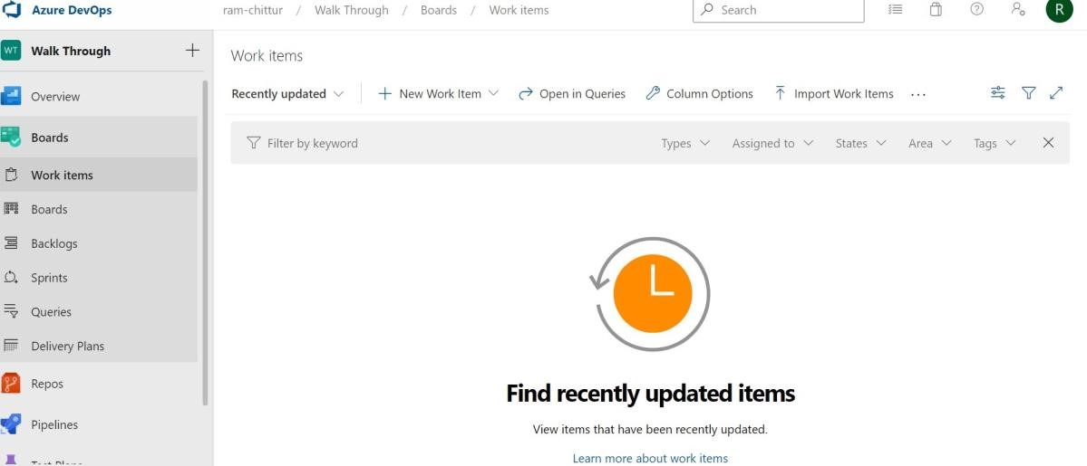
Azure Boards: Walk through
Click on Create New Organization.
Name your Azure DevOps organization - say IIT-PKD ⦁ Create a project, say your course name. You can make it private and invite others.
On the left hand pane, click on Boards->Work items. It should look somewhat like this.
-

Slide 4
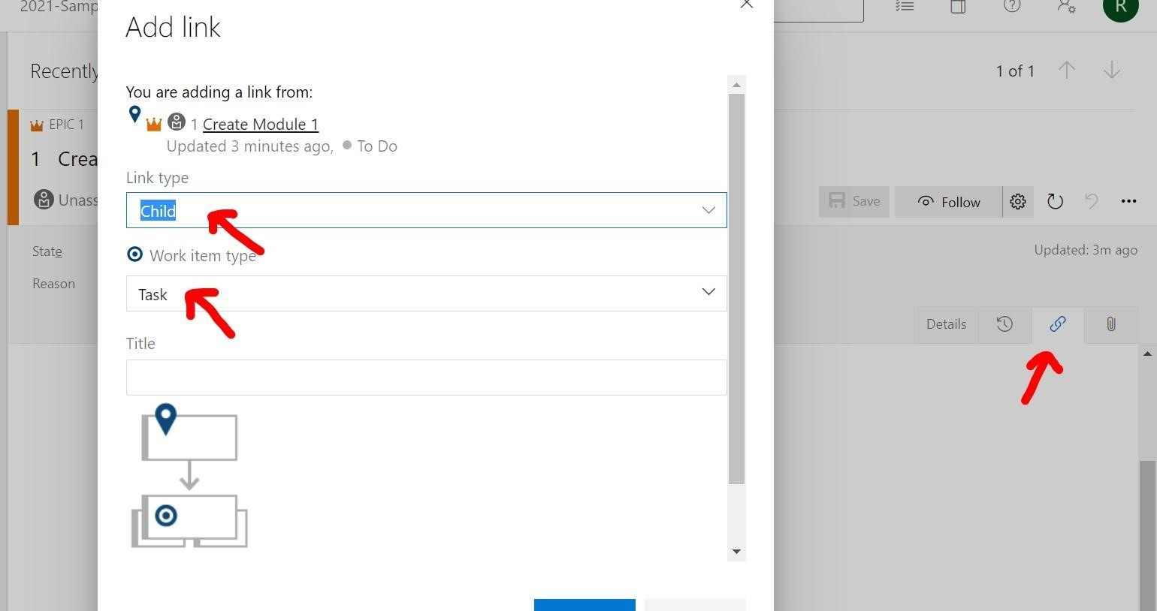
Azure Boards: Walk through
Create "Epics" - one for each big scenarios. Like say, one for Networking Module, another for ScreenShare etc. Those can be assigned to the team leads. Create another for "Setting up Github" and assigned to the project manager. Yet another for "Project Spec" and assigned to the Technical Architect. And so on.
Now you can go into each "Epic" and create child tasks. Assign it to the individual owners, and give an estimate on the number of days required. It is ok if the estimate is off the mark; that is something we will learn as part of this project and will get better at over time.
-

Slide 5
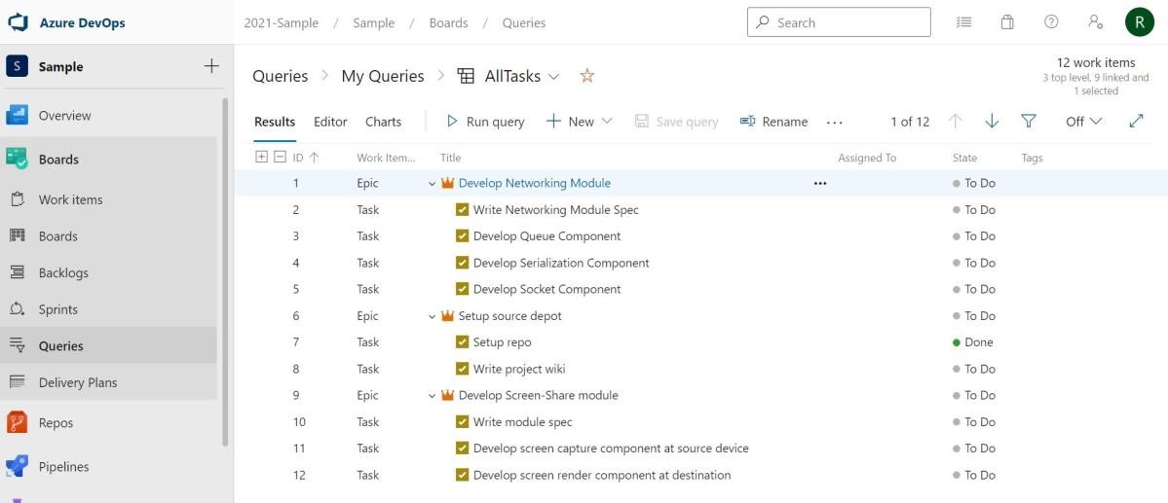
Azure Boards: Walk through
Please discuss with your team and create the various scenarios/tasks. It is ok if we can't foresee everything that is required. Let us take a first shot at it. Here is a snippet of how it might look after you are done with the initial iteration. This is just a sample; of course you will have a lot more tasks on your list.
-
You should be able to link your github commits to these tasks so that we can correlate the code/specs for each task. See Connect an Azure Boards or Azure DevOps project to a GitHub repository - Azure Boards | Microsoft Learn.

Slide 6
Example
Azure Boards from one of the previous years’ student project: Work items - Boards (azure.com)

